Slide 1

Market Data Management System with User Authentication
The Market Data Management System designed for both security and user-friendly analytics. This system empowers you to make informed business decisions with real-time market insights.
PRESENTED BY: TEAM 1
Harshith Sai
Dumpati Ravali
Vanishree Srinivas

Slide 2
Project Overview Of Milestone 1
Objective
Key Features
Develop a platform that combines user authentication with secure and interactive access to market data, delivering personalized insights.
The system leverages a robust backend for user authentication, real-time data retrieval, and powerful visualization tools for market trends.

Slide 3
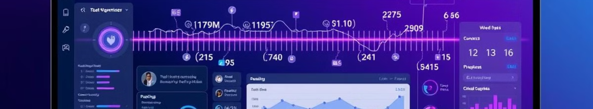
Key Components of Milestone 1
User Authentication System
Market Data Management
FastAPI with OAuth2(Open Authorization) secures user login, validates credentials, and manages user sessions for a personalized experience.
The system integrates with APIs and pre-loaded datasets, offering real-time and historical data retrieval, along with powerful visualization tools.

Slide 4
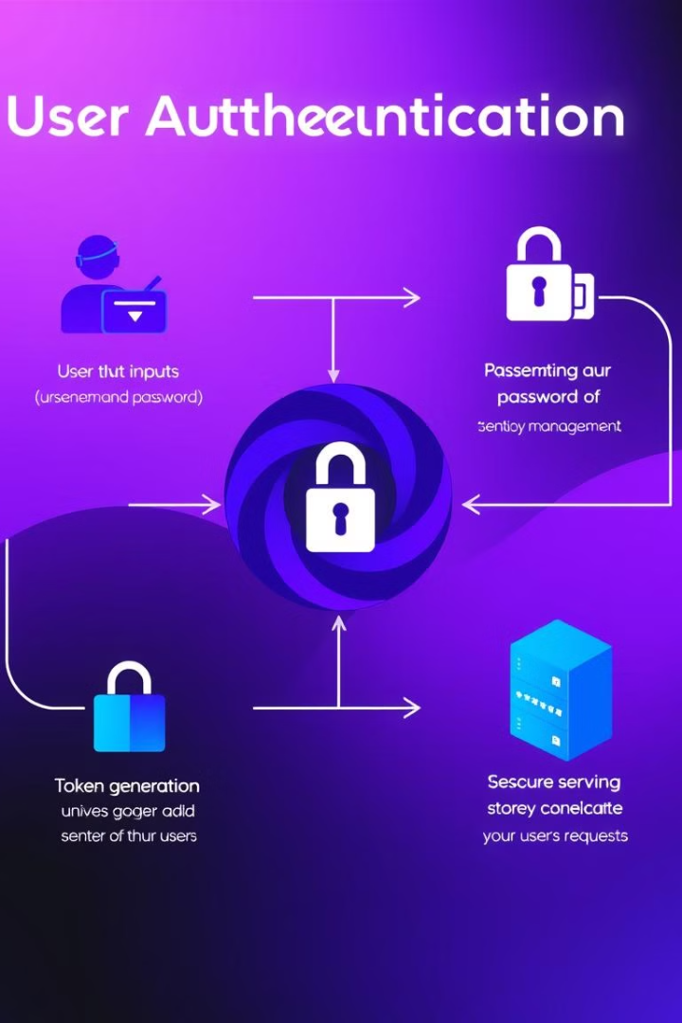


User Authentication
Secure Login
The system utilizes FastAPI with OAuth2 for secure login functionality, protecting user data and access.
Token-Based Authentication
Access tokens are issued to authenticated users, enabling secure session management and personalized experiences.

Slide 5
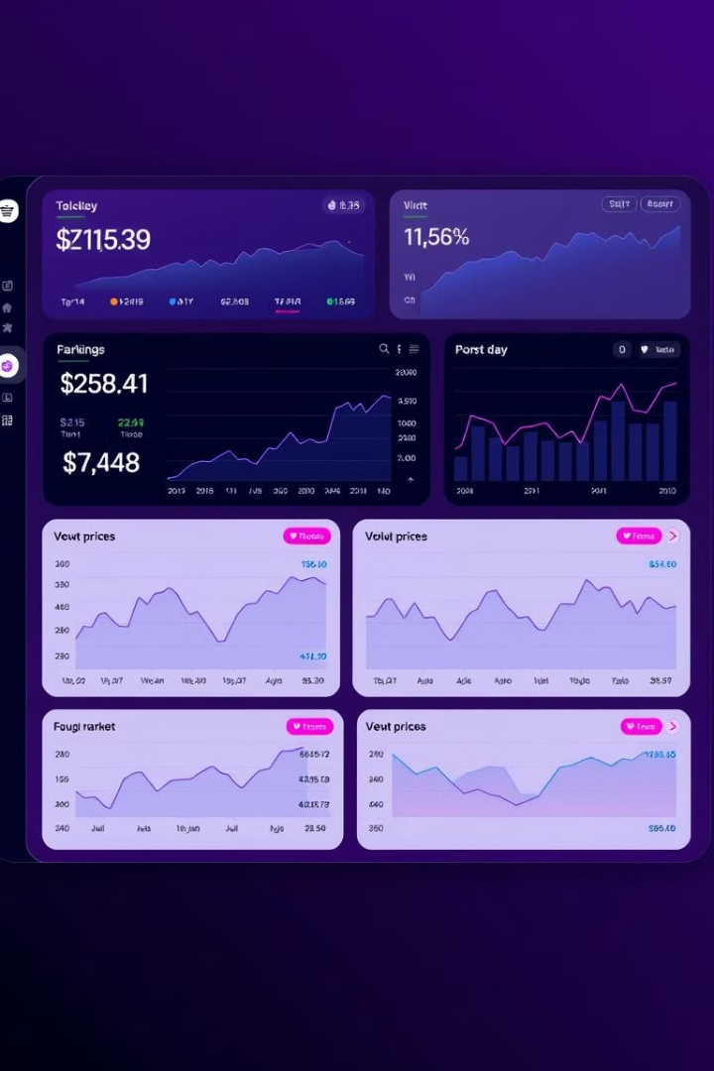


Market Data Dashboard
Data Filtering
Interactive Charts
Users can filter market data by specific criteria, such as product, region, or time period.
The dashboard provides real-time visualizations of market trends using interactive charts.

Slide 6

Benefits
Security
Data Insights
Robust user authentication ensures secure access to sensitive market data, protecting against unauthorized access.
Users gain valuable insights from real-time market trends, empowering them to make informed business decisions.

Slide 7

Tools and Technologies
1
2
FastAPI
Streamlit
Powers the backend for RESTful APIs and user authentication, enabling secure and efficient data handling.
Streamlit creates the interactive user interface, providing a user-friendly platform for data exploration and analysis.

Slide 8
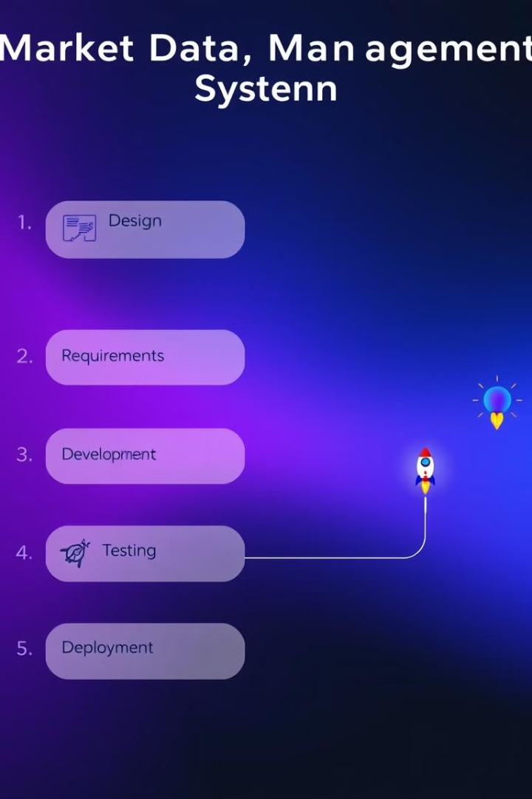
Development Process
1
Requirement Gathering
Understanding user needs and defining system requirements is crucial for successful development.
2
Development and Testing
The system is built using a comprehensive testing approach to ensure quality and functionality.
3
Deployment and Maintenance
After rigorous testing, the system is deployed and maintained to ensure its ongoing performance and security.

Slide 9
Environment Setup
Project Initialization
1
Install Python and VS Code, ensuring "Add Python to PATH" is checked during installation.
Virtual Environment
Create a virtual environment for managing project dependencies and isolating the project from system-wide Python packages.
2
Install essential VS Code extensions: Python, Pylance, and Material Icon Theme.
Library Installation
Create a project folder, named "MarketDataManagement" for organizing all project files.
Install essential libraries using pip: pandas, matplotlib, streamlit, fastapi, and uvicorn.
3
File Creation
Create project files: app.py for the API backend, dashboard.py for the Streamlit dashboard, and market_data.csv for data storage.

Slide 10








Development
Backend Development with FastAPI
Frontend Development with Streamlit
Dashboard Creation
API Endpoints
Develop an interactive dashboard using Streamlit, providing a user-friendly interface for visualizing market data.
Create FastAPI endpoints (/markets/, /markets/{market_name}) for interacting with the market data.
Data Filtering
Include a dropdown to filter data by market, allowing users to focus on specific regions or categories.
Data Loading
Data Visualization
Load the market data CSV file using pandas for efficient manipulation and processing.
Display the filtered data in a table format and use Streamlit's charting capabilities to create visually engaging line charts.
Dashboard Launch
Run Server
Run the Streamlit dashboard on http://localhost:8501 to access and interact with the visualized data.
Run the FastAPI server using uvicorn to make the API accessible.
API Testing
Use Swagger UI at http://127.0.0.1:8000/docs to test the API and ensure its functionality.

Slide 11




Testing and Validation
Install Pytest
1
Install Pytest (pip install pytest) for comprehensive testing of the API.
Test File Creation
2
Create a test file (test_app.py) dedicated to writing test cases for the API endpoints.
Write Test Cases
3
Implement test cases that cover various API functionalities, including data retrieval and error handling.
Run Tests
4
Execute the tests using pytest to ensure that the API code behaves as expected.

Slide 12
Dashboard Enhancement
Deployment and Maintenance
1
1
2
Deployment
3
Deploy the backend API and frontend dashboard to a cloud platform for easy access.
4
2
1
VS Code Enhancement
Leverage the Material Icon Theme for a visually appealing file structure and a more organized workspace.
Monitoring
2
Code Formatting
Continuously monitor the system's performance and availability to identify and address issues promptly.
Use the black library for consistent code formatting, enhancing readability and code quality.
3
3
Streamlit Customization
Add a custom background image to personalize the dashboard and enhance its visual appeal.
Updates
4
Styling and Layout
Regularly update the system with new features and data sources to keep it relevant and insightful.
Tailor Streamlit's styles to create a user-friendly interface with enhanced readability and visual appeal.
4
Support
Provide ongoing support and documentation to ensure users can effectively utilize the system.

Slide 13
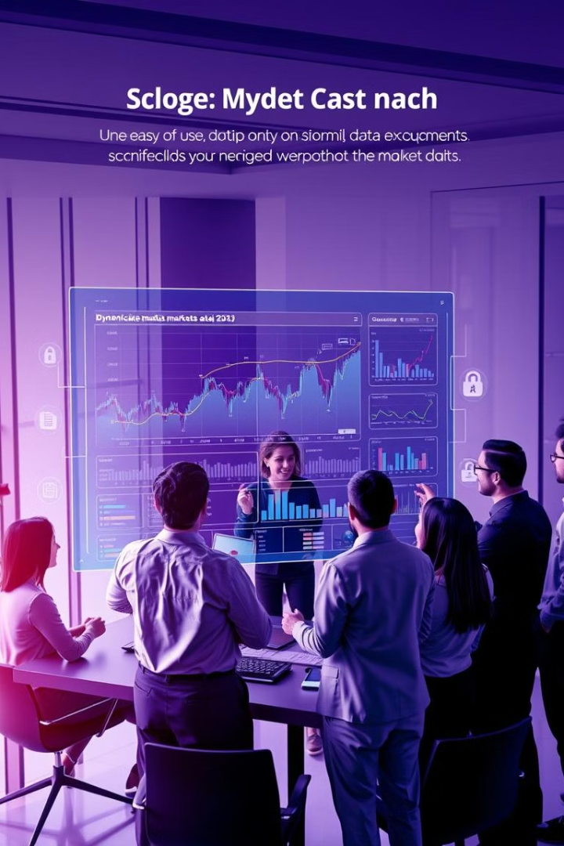
Conclusion
In conclusion, the Market Data Management System is a comprehensive solution that combines a secure backend using FastAPI, an interactive dashboard with Streamlit, and advanced functionalities like data filtering, trend analysis, and visualization. By integrating User Authentication, the system ensures secure access, protecting sensitive market data while maintaining a seamless user experience. This project demonstrates the effective use of modern tools to create a scalable and secure platform, providing a strong foundation for future enhancements such as real-time data integration and predictive analytics.

Slide 14
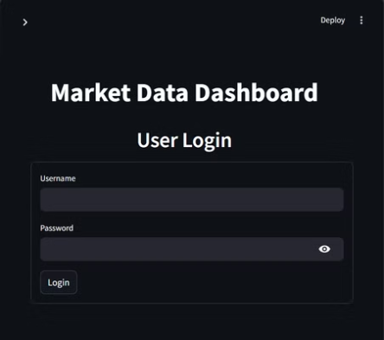
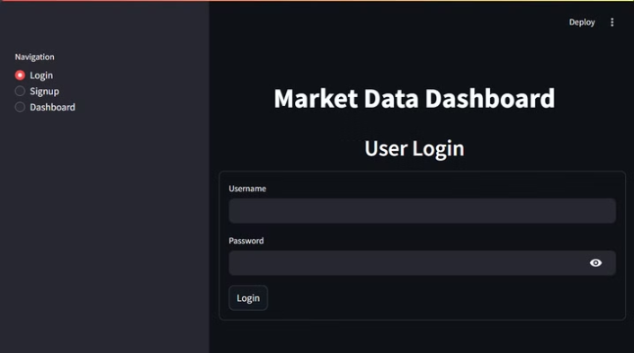
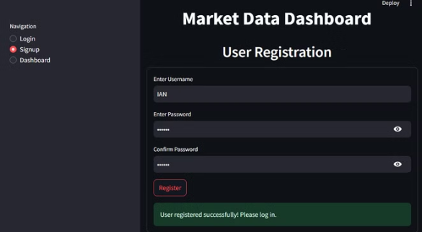
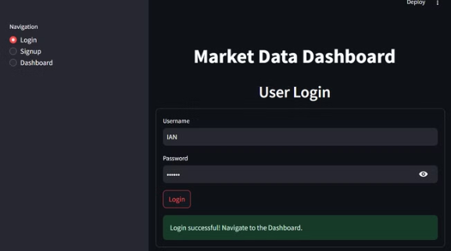
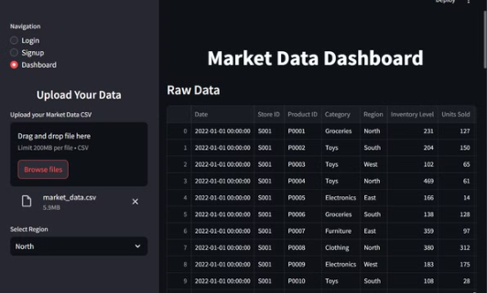
OUTPUT:

Slide 15
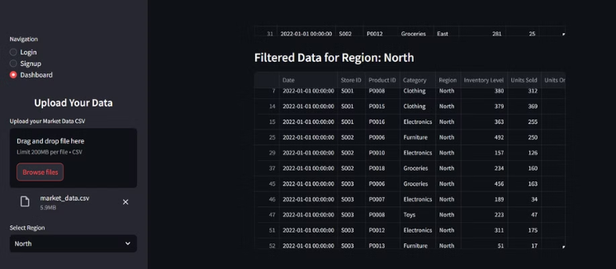
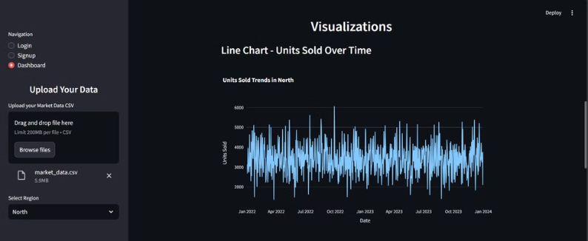
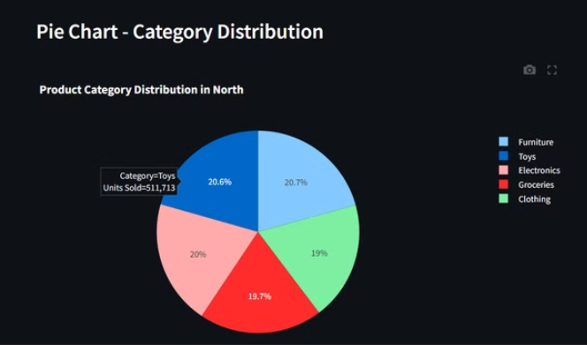
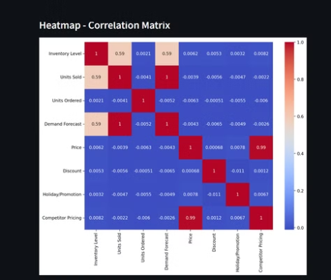

Slide 16

THANK YOU
Thank you for your time and consideration. We look forward to collaborating with you on this project.

